Slide 1
MALIHUB GROUP PRESENTATION
Industrial-Based Learning (IBL) Module
Technical University of Kenya
Samuel Kamanda – Tech Lead & Database Administrator
Promise Mbalu – System Architecture
Elsie Idaya – Frontend
Shemaiyah Leelban – Backend
Malihub MVP ver.1

Slide 2
Problem Statement
The Core Challenge: Many individuals struggle to track their daily spending, making it difficult to control expenses and stick to a budget.
Flaws of Existing Methods
Manual Paper Records: Inefficient, slow to update, and easy to lose.
Spreadsheets: Tedious to update on mobile phones and prone to user errors.
Why It Matters: Without a simple tool to log daily expenses, students and young professionals struggle to build good financial tracking habits early on to build financial awareness.

Slide 3
Objectives & Scope
Primary Objective: To deliver a simple, manual Personal Finance Management System that helps users track their income and expenses.
Core Capabilities (MVP)
-The user manually inputs their income and daily expenses.
-The system calculates and works out the remaining balance based on those manual entries.
-Helps users track exactly where their money goes.
System Boundaries (In-Scope)
A functional mobile interface built using Flutter for Android and iOS.
Out of Scope: This system does not automatically connect to or fetch balances from banks, M-Pesa, or any other external finance applications. All data is entered manually by the user.

Slide 4
Tech Stack Overview
Mobile Frontend. Flutter & Dart: Cross-platform framework, enabling deployment to Android and iOS from a single codebase.
Backend REST API. Node.js & Express: Handles routing and JWT-based authentication; a fixed JWT_SECRET environment variable (on Railway) ensures user sessions survive backend redeploys, rather than being invalidated each time.
Database and Hosting. MySQL, managed via Prisma ORM: Stores user data with strongly-typed relationships enforced at the schema level; hosted on Railway.app, with the backend connecting via Railway's internal DATABASE_URL reference.
Version Control & Deployment. GitHub: Team collaboration via Git branches and pull requests; Railway auto-deploys the backend on every push to the main branch.

Slide 5
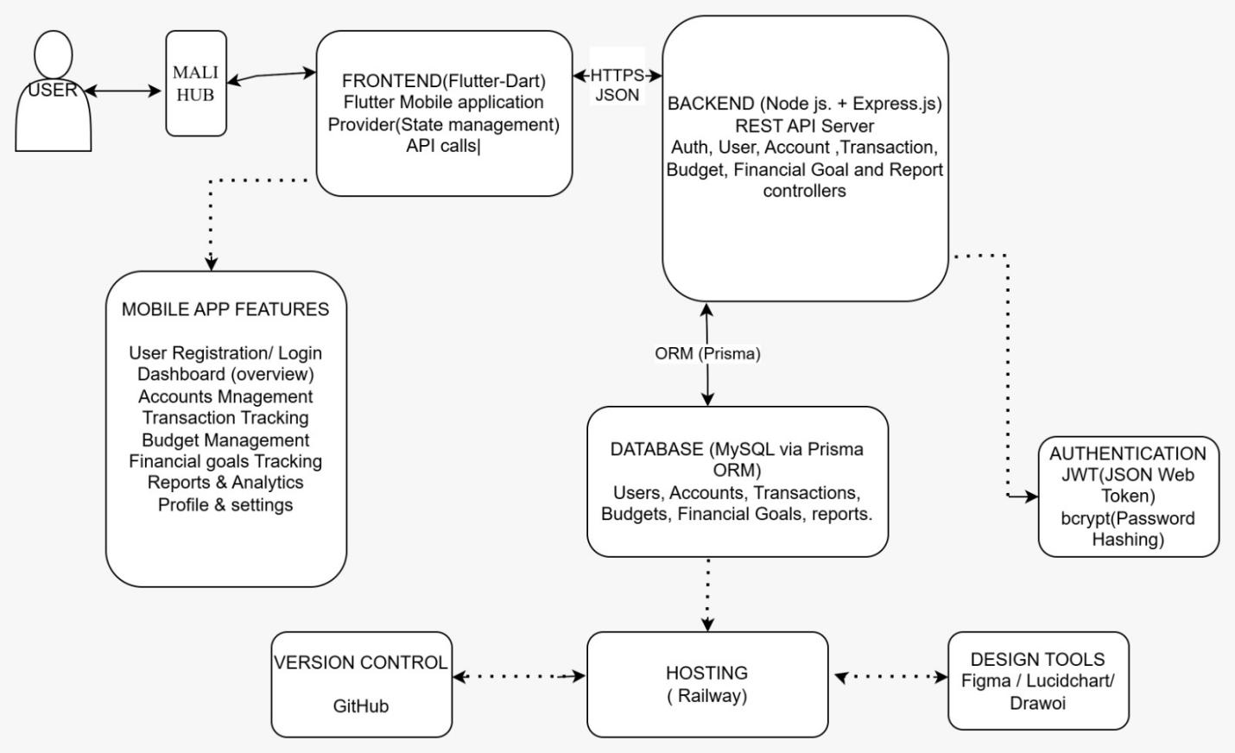
System Architecture Diagram
How Data Flows:
Frontend: User types an expense or income entry into the Flutter mobile interface.
API Backend: The Flutter frontend sends the data securely to the Node.js backend.
Database: The backend updates the MySQL database using Prisma queries.
Response: The system calculates the new balance and sends it back to refresh the user's screen.

Slide 6
Database Design (Structural Mapping)
Database Entity Layout: Organized into relational tables to keep user records structured.i.e, User, Account, Category, Transaction, Budget, Financial Goal and Notification.
Primary Structural Mappings
User to Accounts/Budgets/Goals: A User can create multiple accounts, budgets, and goals.
Account to Transaction: Every transaction (income or expense) must belong to a specific account.
Category to Transaction: Transactions are linked to categories (like Food or Rent) for clean tracking.
Category to Budget: Budgets are set against specific spending categories to prevent overspending.

Slide 7
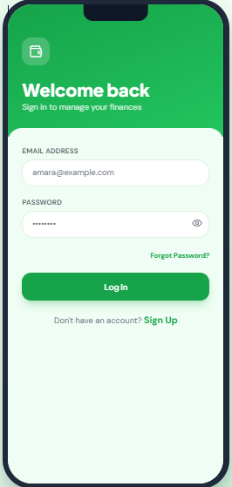
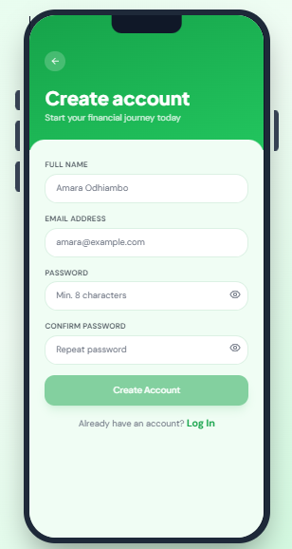
User Authentication Wireframe
Interface Description:
Sign Up / Login Screen: Clean input fields for full name, email, and password.
Security Rule: Passwords are fully encrypted and hashed on the backend using bcrypt before being saved to the database.

Slide 8
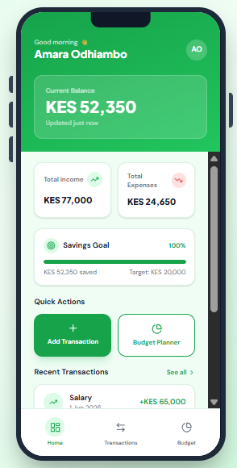
Dashboard & Transaction Logging Wireframe
Interface Description:
Dashboard Screen: Shows the user their manually calculated total balance at the top, followed by summaries for total income and total expenses.
Add Transaction Screen: A straightforward form where the user manually types the amount and selects the correct category from a dropdown menu.

Slide 9
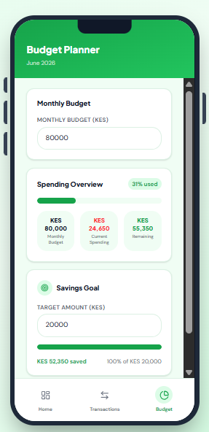
Analytics & Budget Wireframe
Interface Description:
Budget Screen: Lists user-defined spending categories alongside progress indicators showing how much of the limit has been used up.
Note for the Panel: This insight/visual layout is purely for presentation and demonstration purposes to show how visual budget boundaries help users track spending effectively. Its full capabilities have not been implemented in this MVP (reference “Future recommendations ” in Malihub SRS).

Slide 10
Design System
Visual Direction: Kept clean and minimalist to focus completely on readability.
Color Palette Rules
Green: Used intentionally for positive balances and income logs.
Red: Used to highlight expenses and budget limits.
Typography: Uses standard, highly legible text sizes for clear data scanning on mobile screens.

Slide 11
BACKEND
Node.js + Express to create REST API server.
Prisma ORM for type-safe database access layer.
MySQL to create relational database.
Core Responsibilities
User authentication & authorization. JWT (7-day expiry) + bcrypt password hashing.
REST APIs for Accounts, Transactions, Categories, Budgets, and Financial Goals.
Server-side computation of budget metrics (spent, remaining, % used), kept out of the client to ensure one source of truth.
Notification inbox management (fetch, mark-as-read, delete).

Slide 12
Deployment
Hosted on Railway by a MySQL database service created by establishing a connection though ports with a local MySQL server.
Continuous deployment, auto-deploys on every push to GitHub.
Fixed environment variables (e.g. JWT_SECRET) to keep user sessions stable across redeploys.

Slide 13
Technical Challenges & Solutions
Challenge: High Hardware Resource Demand
Running the Android Studio’s IDE alongside heavy virtual mobile devices (Android Emulators) took up massive amounts of memory and resources on our laptops. This slowed down development and caused frequent system freezes.
As a solution, shifted to testing and running the Flutter applications directly on our physical mobile devices via USB debugging. This bypassed the emulators entirely, freed up computer resources, and significantly sped up our code testing loop.
Challenge: Team Database Schema Synchronization
Merging different git branches occasionally caused local database states to go out of sync.
As a troubleshoot, we established a strict protocol where team members ran Prisma migration synchronization commands immediately after pulling code updates.

Slide 14
Challenge: Third-Party Email Delivery on Cloud Hosting
Built password recovery using Nodemailer over Gmail SMTP
Discovered Railway's hosting environment lacks reliable outbound SMTP connectivity (blocked/limited IPv6 egress on standard mail ports)
Diagnosing and resolving a hosting-specific networking issue carried real time cost within a tight 3-week timeline
Resolution: Deprioritized in favor of finishing core MVP features (auth, transactions, budgets, goals); scoped in for a future release once the delivery issue can be properly resolved.

Slide 15
Future Considerations
Scalability and Containerization. Package backend services in Docker to standardize the runtime environment and simplify moving between hosting providers.
Tech Stack changes and evolution. Migrate from MySQL to PostgreSQL for better performance on growing transaction history; evaluate Postgres-native hosts (Render, Supabase, Firebase) as Railway alternatives for backend hosting.
App Distribution. Move from usb-debuging for installation to direct APK distribution (Firebase App Distribution or even Google Play internal testing) so users can install Malihub on their devices conveniently.
Automated Safeguards: Introduce unit and integration tests for financial calculations, run automatically before every deployment.
Automated Insights: Analyze historical transaction data to auto-generate spending summaries, budget against actual alerts, and goal progress forecasts.

Slide 16
THE END OF MALIHUB PRESENTATION

